Slide 1
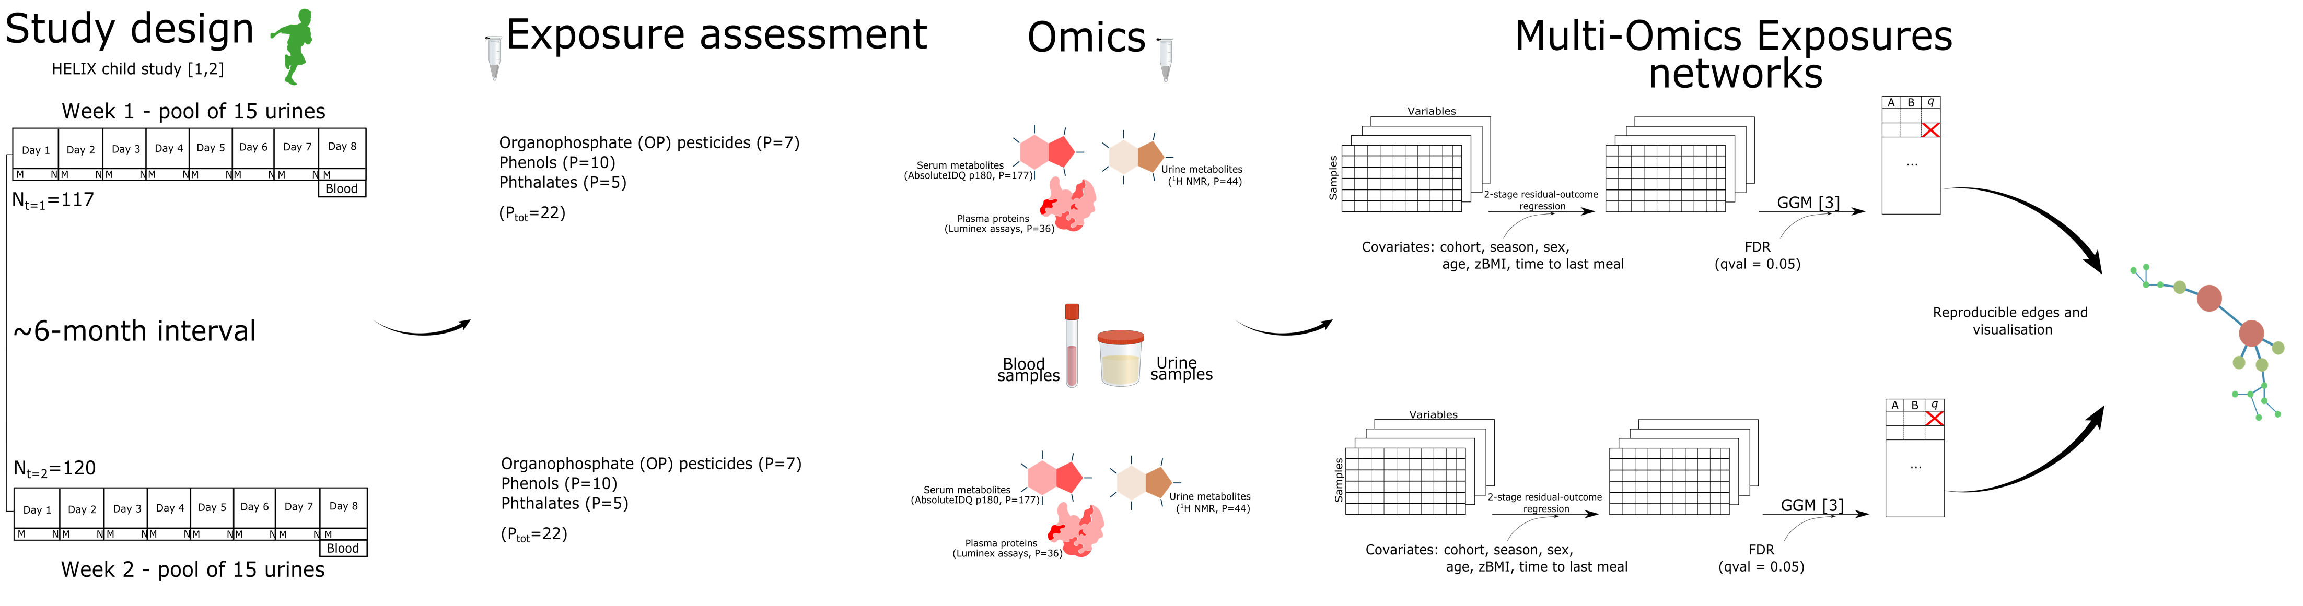
Childhood exposure to non-persistent endocrine disrupting chemicals and multi-omic markers in a population-based child cohort
Lorenzo Fabbri*^{1,2} Ronan Garlantezec¹⁰ Cathrine Thomsen⁴ John Wright⁵ Remy Slama⁶ Barbara Heude⁷ Regina Grazuleviciene⁸ Leda Chatzi⁹ Chung-Ho E Lau^{11,12} Alexandros P Siskos¹³ Hector Keun¹³ Maribel Casas^{1,2,3} Martine Vrijheid^{1,2,3} Lea Maitre^{1,2,3}
¹ISGlobal, Barcelona, Spain ²Universitat Pompeu Fabra (UPF), Barcelona, Spain ³CIBER Epidemiologia y Salud Pública (CIBERESP), Madrid, Spain ⁴Department of Environmental Health, Norwegian Institute of Public Health, Oslo, Norway ⁵Bradford Institute for Health Research, Bradford Teaching Hospitals NHS Foundation Trust, Bradford, UK ⁶Team of Environmental Epidemiology applied to Reproduction and Respiratory Health, Institute for Advanced Biosciences (IAB), Inserm, CNRS, Université Grenoble Alpes, Grenoble, France ⁷Université de Paris, Centre for Research in Epidemiology and Statistics (CRESS), INSERM, INRAE, Paris, France ⁸Department of Environmental Sciences, Vytautas Magnus University, Kaunas, Lithuania ⁹Department of Preventive Medicine, Keck School of Medicine, University of Southern California, Los Angeles, CA, USA ¹⁰Univ Rennes, CHU Rennes, Inserm, EHESP, Irset (Institut de recherche en santé environnement et travail), UMR_ S 1085, Rennes, France ¹¹MRC Centre for Environment and Health, School of Public Health, Imperial College London, London, UK ¹²Division of Systems Medicine, Department of Metabolism, Digestion and Reproduction, Imperial College, South Kensington, London, UK ¹³Cancer Metabolism & Systems Toxicology Group, Division of Cancer, Department of Surgery and Cancer & Division of Systems Medicine, Department of Metabolism, Digestion & Reproduction, Imperial College London, Hammersmith Hospital Campus, London, UK *For further information contact: lorenzo.fabbri@isglobal.org
Background & Objectives
The general population is exposed to a cocktail of chemical exposures
Non-persistent endocrine disruptors (EDCs) are a class of chemicals that interfere with the endocrine system
The early stages of life are particularly vulnerable to the effects of EDCs
Multi-omic signatures might provide mechanistic insights into the effect of EDC exposure, in particular before the onset of clinical symptoms in children
We aimed to identify multi-omic signatures associated with non-persistent EDCs using an integrative approach based on Partial Correlation Networks
Methods
Results
The time-specific networks (N_{edges}=1,064, N_{edges}=1,109) included associations of comparable strength (ρ=0.09 (-0.09, 0.11) for both) and statistical significance (q=0.008 (0.001, 0.025), q=0.01 (0.001, 0.027)). The significant edges represented less than 3% of the possible connections
The merged network consisted of N_{edges}=229
Graph merging led to the exclusion of the majority of exposure-omic connections (Figure 1). Notably, none of the protein-exposure associations were reproducible
The merged network consisted of 32 connected components, 3 of which included mixed exposure-omic connections (Figure 2)
Figure 2. Clusters (i.e. connected components) of EDC exposure-omic associations.
Figure 3. Merged network showing all the connected components.
Figure 1. Multilevel pie chart showing the proportion of edge types for the time-specific and merged networks. e = exposure, ms = serum metabolite, mu = urinary metabolite, p = protein.
Conclusions
We integrated Multi-Omic and exposure data from a child cohort using an integrative approach, and we identified associations reproducible across time points
The association between DEP and Serotonin (ρ=0.09 for both time points) was reproducible. Exposure to Organophosphate pesticides has been linked to a variety of brain disorders [4], potentially through the serotonergic system
In future work we plan to include methylation data
References [1] Vrijheid M, et al. "The human early-life exposome (HELIX): project rationale and design." (2014). [2] Casas M, et al. "Variability of urinary concentrations of non-persistent chemicals in pregnant women and school-aged children." (2018). [3] Schafer J, Strimmer K. "A Shrinkage Approach to Large-Scale Covariance Matrix Estimation and Implications for Functional Genomics." (2005). [4] Sarrouilhe D, et al. "Is the Exposome Involved in Brain Disorders through the Serotoninergic System?" (2021)

